Slide 1
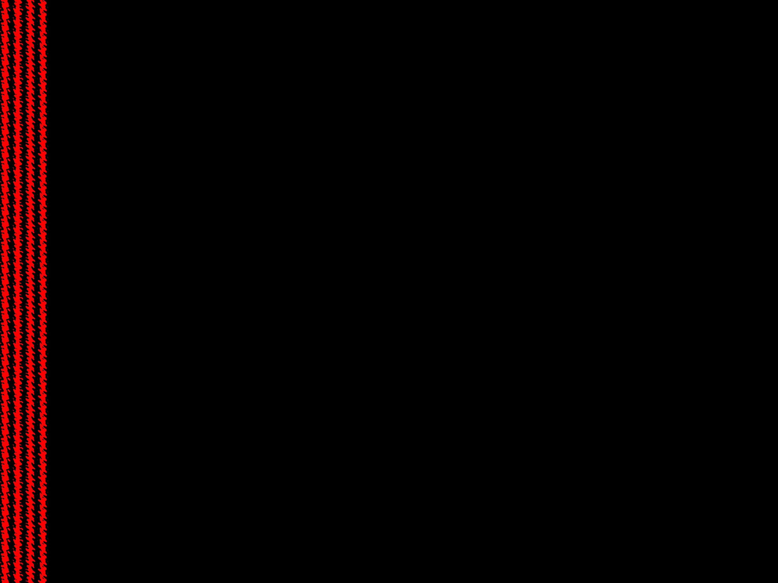
Functions
Session 9

Slide 2
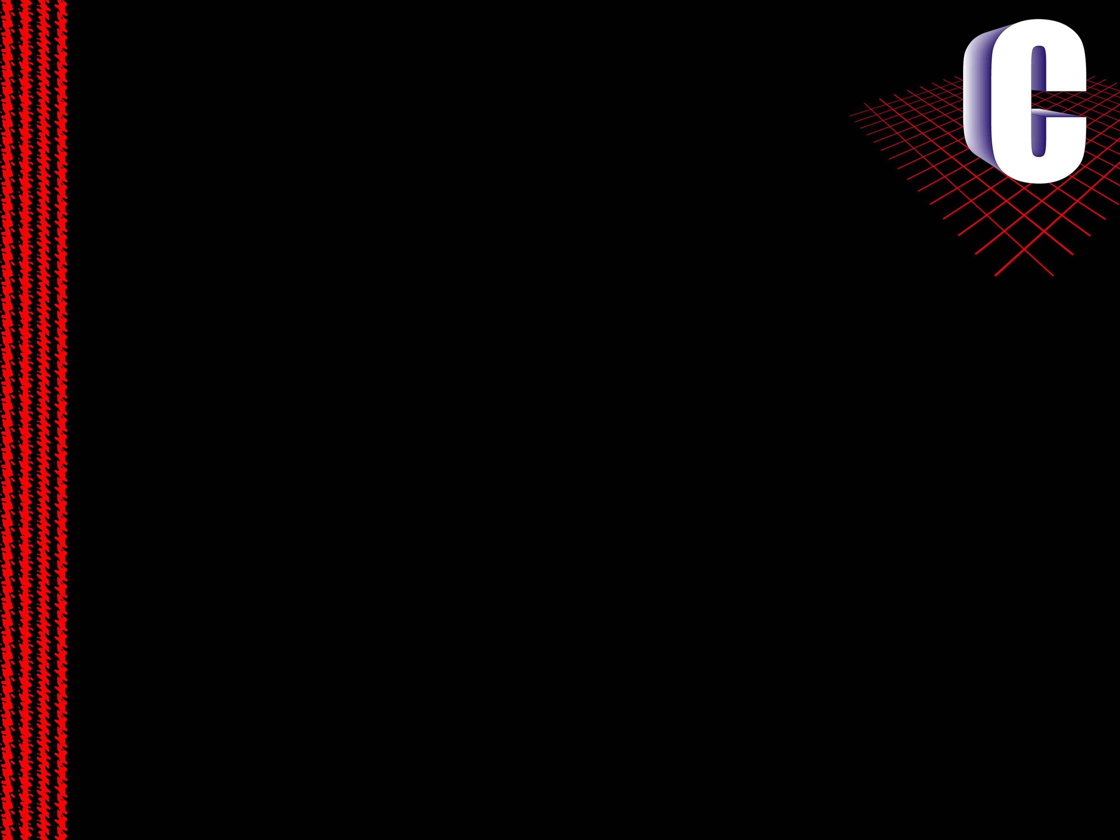
Orientations Of Languages
The programming languages are of the following orientations
  Mono – Lithical Languages
  Procedure Oriented Languages
  Object Oriented Languages
  Event Driven Languages
The last two are not of much importence as if now, let us discuss about the first two.

Slide 3
Mono-Lithical Languages
Programs of these languages are a list of instructions or statements.
The execution is done from the first statement to the last statement in a sequence.
In this pattern, if a piece of code, that has already been written previously, is needed again, then it should be rewritten.
The previous copy can not be reused.

Slide 4
Procedure Oriented Language
The program here is a collection of procedures.
Each procedure is a list of instructions.
This enables to link a procedure in our program for any number of times needed, hence enabling code re-usability
Languages like c are examples of this category
Procedures are called with different names in different languages, like functions in c and c++, methods in java ..etc.,
There is also a rule that every program now should start execution from a procedure (function) called main.

Slide 5
Functions
Function is a self-content well defined sub block of a program .
Each function targets a single task.
Function are both pre-defined and user-defined
Functions like clrscr, gets, strlen, scaf, printf ..etc are pre-defined functions.
main is a user-defined function.

Slide 6
User Defined Functions
To define a function for our own the following statements are to be placed.
  Function Declaration
  Function Definition
  Function Call
For pre-defined functions Function Call is only done by us, declarations and definitions are done by the developers already.

Slide 7
Function Declaration
Function declaration is a statement that informs the computer three things about the function
  Function name
  Return Type
  Parameters/Argument List
Syntax:
return_type fun_name(param_data_type_list);
Example:
int sum(int,int);
Function name is any name given by the user to identify the function. It should follow identifier rules

Slide 8
Function Declaration [contd]
As Function is a task, it may need a few data items to start with, or it may not. Such data items are called the parameters or arguments.
After the task is completed it may give back a value or it may not, such value is called the return value. Data type of the return value is called the return type of the function. If the function doesn’t return any value, it is said to return void.
Thus return type of main is void.
A function can return either no or one value only.
The function declaration is also called function signature or prototype.

Slide 9
Function definition
Function definition is where the function is coded, for what it has to do.
Syntax:
return_type fun_name(param_lisr)
{
code…
}
Example
int sum(int a,int b)
{
int c;
c = a+b;
return c;
}
Remember that defining a function will not execute it. Function is executed only when it is called.

Slide 10
Function Call
Function call is requesting a function to execute.
A function can be called any number of times and any where in a program.
When a function is called it is called by its name, and it should be passed with parameter values (if any).
When a function returns, the return value can be
  received into another variable,
  or can be used in an expression or
  can be passed into another function
  or may not be received at all.
Example:
  x=sum(10,20);
  printf(“%d”,sum(15,x));
  p = q*sum(a,b);
  Sum(12,3);

Slide 11
Various possible function types
Functions can be any kind of the below
  Function with return type and parameters
  Function with return type but no parameters
  Function with paramters but no return type
  Function with no return type and no paramters
There are no concrete rules, for how function should be, the return type or paramters of the function are to be decided by the programmer according to his convenience

Slide 12
Session 3
Functions

Slide 13
Session Objectives
Explain the use of functions
Explain the structure of a function
Explain how a functions are declared
Explain function prototypes
Explain the different types of variables
Explain how to call functions
Explain scope rules for a function

Slide 14
Use Of Functions
Functions are generally used as abbreviations for a series of
instructions that are to be executed more than once.
Functions are easy to write and understand.
Debugging the program becomes easier as the structure of the
program is more apparent, due to its modular form.
Programs containing functions are also easier to maintain,
because modifications, if required, are confined to certain
functions within the program.

Slide 15

The Function Structure
The general syntax of a function in C is :
The type_specifier specifies the data type of the value, which
the function will return.
A valid function name is to be assigned to identify the
function
Arguments appearing in parentheses are also termed as
formal parameters.

Slide 16
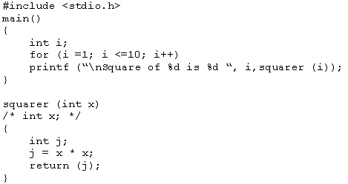
Arguments of a function
In the following example :
Actual Arguments
Formal Arguments
The data is passed from the main() to the squarer() function
The function works on data using arguments.

Slide 17
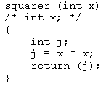
The return Statement
It transfers the control from the function back to the calling
program immediately.
Whatever is inside the parentheses following the return
statement is returned as a value to the calling program.

Slide 18
Data Type of a Function
The type_specifier is not written prior to the function
squarer(), because squarer() returns an integer type value.
The type_specifier is not compulsory if an integer type of
value is returned or if no value is returned.
However, to avoid inconsistencies, a data type should be
specified.

Slide 19
Invoking a Function
A semicolon is used at the end of the statement when a
function is called, but not after the function definition.
Parentheses are compulsory after the function name,
irrespective of whether the function has arguments or not.
Only one value can be returned by a function.
The program can have more than one function.
The function that calls another function is known as the calling function/routine
The function being called is known as the called function/routine

Slide 20
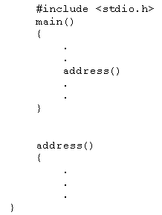
Function Declaration
Declaring a function becomes compulsory when the function is
being used before its definition.
Consider the following example -
The address() function is called
before it is defined.
If the function is not declared
before calling, a compilation
error will occur.
?
Function should have a prototype
This is sometimes referred to as Implicit declaration

Slide 21
Scope of Variables
Global Variables
Local Variables

Slide 22
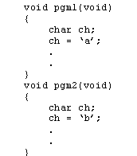
Local Variables
A local variable is created upon entry into a block and
destroyed upon exit from the block.
ch of pgm1 and ch of pgm2 have no relation as each variable ch is known only to the code where it is declared

Slide 23
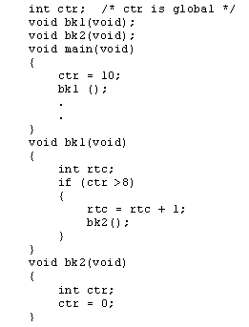
Global Variables
Global variables are visible to the entire program, and can be used by any piece of code
ctr is available for the main(), bk1() and bk2()
They are declared outside any function of a program and hold their value throughout the program execution

Slide 24
Calling The Functions
Call By Value
Call By Reference

Slide 25
Calling By Value
In C, by default, all function arguments are passed by value.
When arguments are passed to the called function, the values
are passed through temporary variables.
All manipulations are done on these temporary variables only.
The arguments are said to be passed by value when the value
of the variable are passed to the called function and any
alteration on this value has no effect on the original value of
the passed variable.

Slide 26
Calling By Reference
In call by reference, the function is allowed access to the
actual memory location of the argument and therefore can
change the value of the arguments of the calling routine.
Call By Reference

